Slide 1
Store Sales - Time Series Forecasting
PRESENTED BY :
Vamshidhar Reddy gurrapagari-vgurappa@kent.edu
Sai Shresta Bireddy - sbireddy@kent.edu
Suma chakravarthy balla- sballa2@kent.edu
Bharat simha reddy pasam – bpasam@kent.edu

Slide 2
statement of the project objectives
In this project we are going to forecast the store sales from corporacion Favorita which is located in Ecuador which is a big grocery retailer. The data includes the store information as well as product information and the particular item is promoted or not and how many number of sales generated in a day as well as weekly and monthly. based on that the time series forecasting will predict the future values.
The purpose of this study it generally gives some basic idea for business peoples. so that they will get some inputs . Based on these inputs they typically understand the procedure of supply chain as well as increasing or decreasing Profits.

Slide 3
Stake Holder
Mr. Sam Sade is Director and chair Person of Sunoco Gas Station which is located in Kent, Ohio.

Slide 4
identify the customer
In the project we identified the customers are the owners of the store corporacion Favorita who approached us about the application with their requirements.

Slide 5
identify the end-users
In the project we identified the end users to be the management staff of the store who needs to know the unit sales of each product.

Slide 6
constraints imposed by the customer
The main constraints imposed are
The time period of products sold
Selling rate of the product
Different categories of people buying different products
Accuracy of model

Slide 7
tools you are expecting to utilize in your project.
Language- Python
To test and train the data- scikit
Visual studio code
Machine learning algorithms

Slide 8
Why is important to solve this problem?
In grocery business, the proposed model can fetch more exact forecasting that can reduced food waste from out-stocking and improve customer satisfaction. The result of this project may eventually ensure your local store has exactly what you need at the next time you shop.

Slide 9
What is linear regression?
Linear regression is defined as an algorithm that provides a linear relationship between an independent variable and a dependent variable to predict the outcome of future events.

Slide 10
Why linear regression?
It is ago-to algorithm because of its simplicity.
It has a very good interpretability.
It performs well on linearly separable datasets( We say a two-dimensional dataset is linearly separable if we can separate the positive from the negative objects with a straight line).

Slide 11
What is xgboost?
XGBoost (eXtreme Gradient Boosting) is a popular supervised-learning algorithm used for regression and classification on large datasets.
It uses sequentially-built decision trees to provide accurate results and a highly-scalable training method that avoids overfitting.

Slide 12
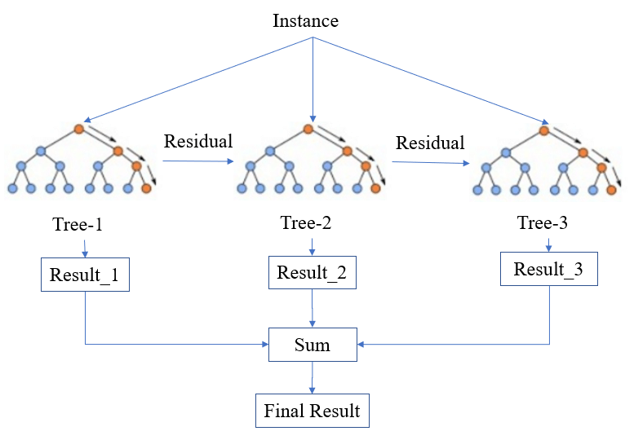

Slide 13
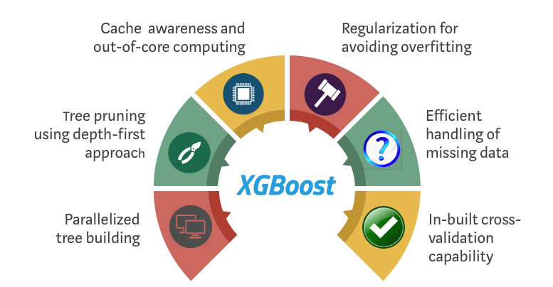
why xgboost?
After comparing with various Algorithms like linear regression, Ridge regression Xgboost yeild better result with respect to Accuracy, MAE and RMSE. So, we choose xgboost.
It is fast and easy to use
Can handle missing values automatically

Slide 14
Data Exploration
We are using 7 different files in the dataset. They are:
1. Holidays_events: Holidays and Events, with metadata.
2. Train: The training data, comprising time series of features store_nbr, family, and onpromotion as well as the target sales.
3. Test: The test data, having the same features as the training data. You will predict the target sales for the dates in this file.
4. Sample_submission: A sample submission file in the correct format.
5. Stores: Stores metadata, including city, state, type, and cluster.
6. Oil: Daily oil price. Includes values during both the train and test data timeframes.
7. Transaction: Dates of transactions

Slide 15
Data Exploration
After going through dataset, we found that no data is missing. Incase if we find any missing data we will replace it with mean value or we could omit them.
we going to use jupyter notebook to run the code.

Slide 16
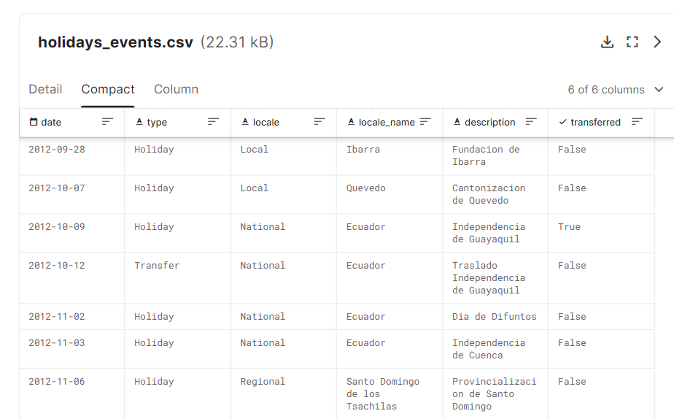
holidays_events.csv

Slide 17
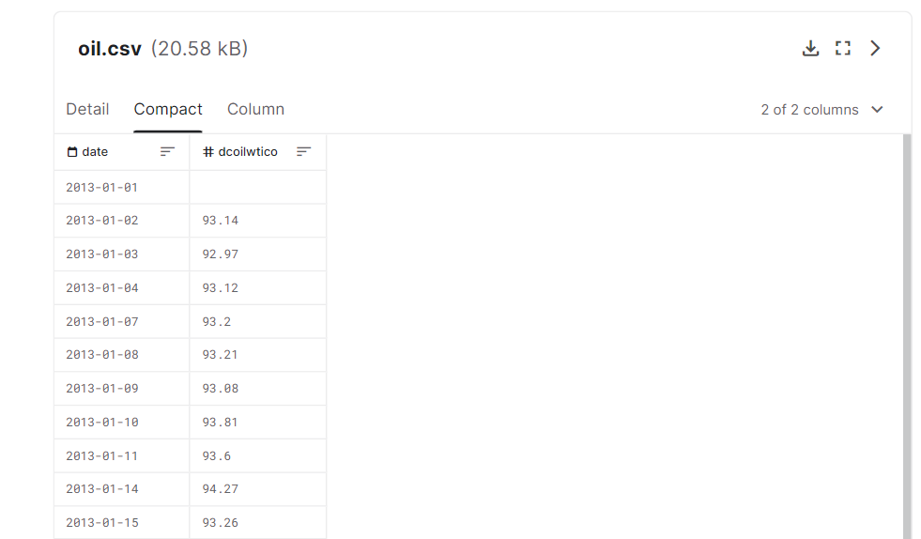
Oil.csv

Slide 18
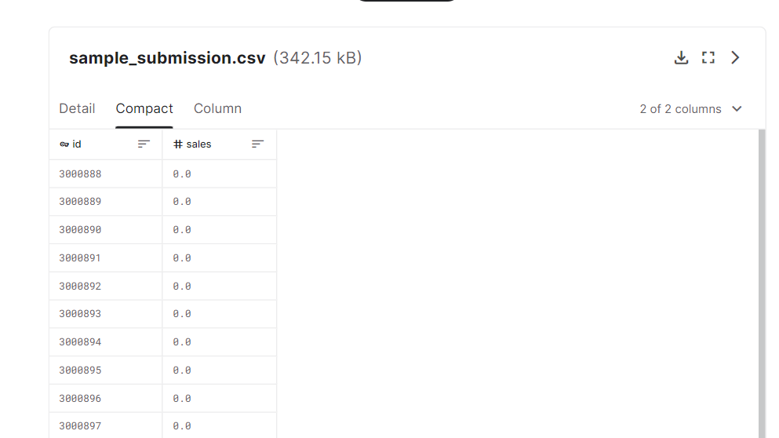
sample_submission.csv

Slide 19
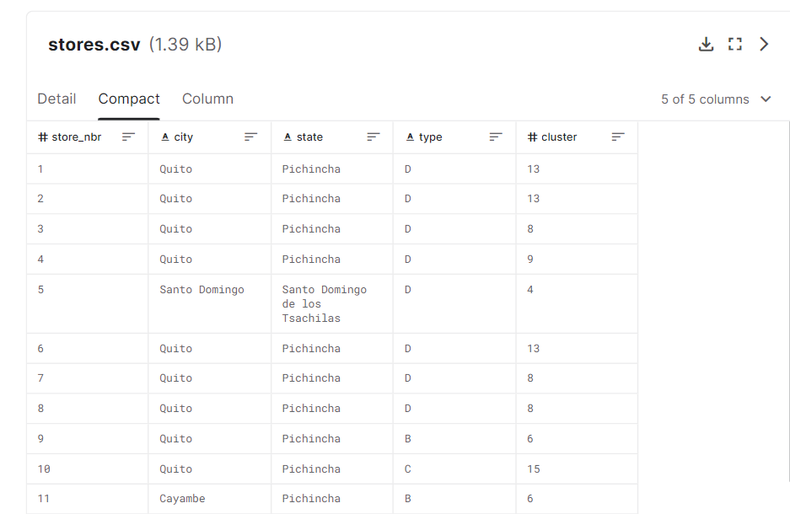
Stores.csv

Slide 20
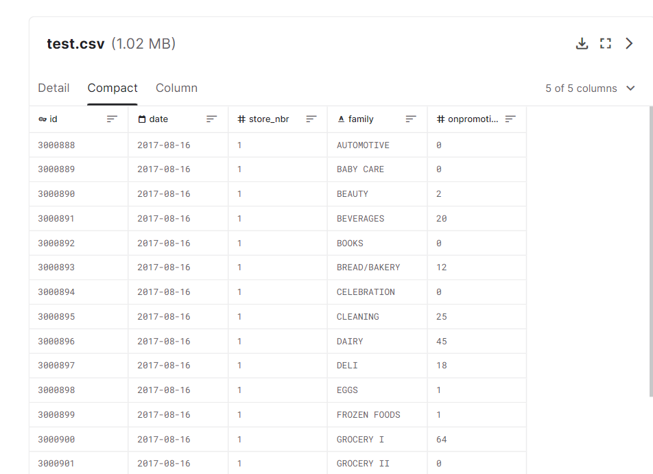
Test.csv

Slide 21
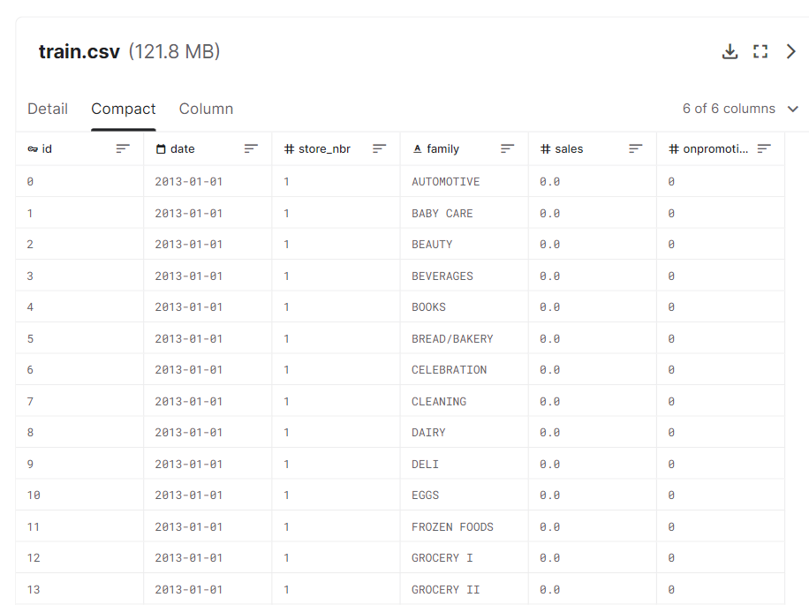
Train.csv

Slide 22
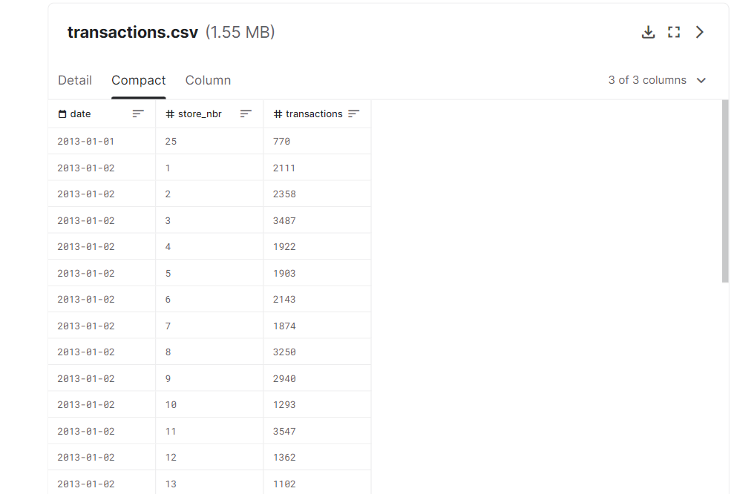
Transactions.csv

Slide 23
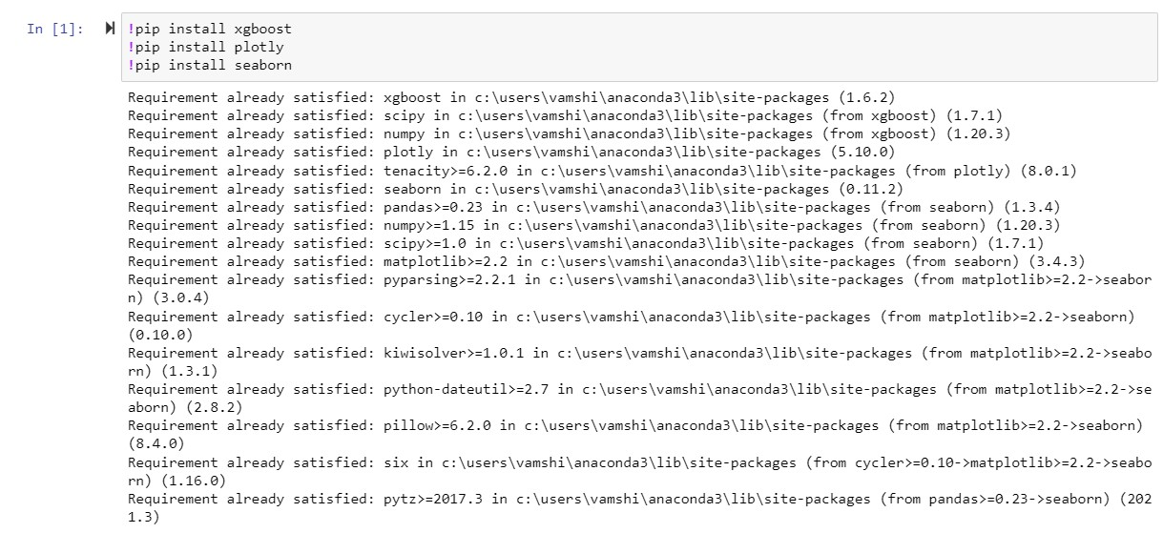
EXECUTION OF PROJECT

Slide 24
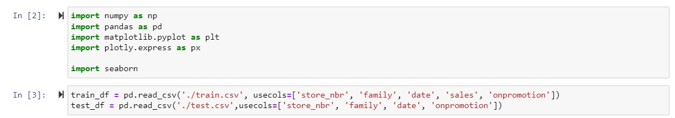
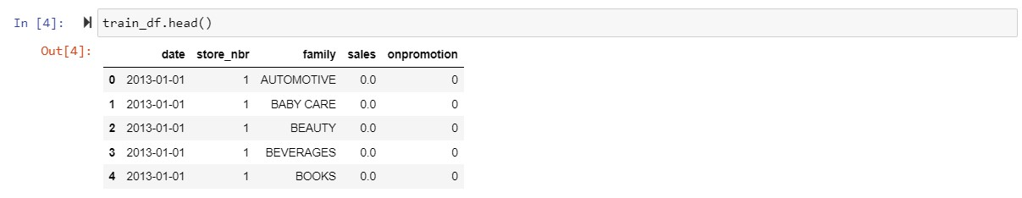

Slide 25
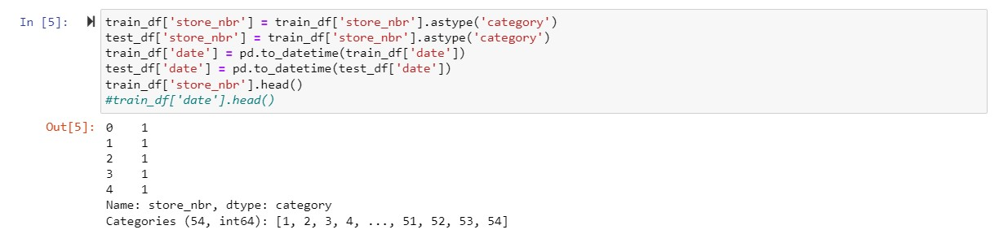
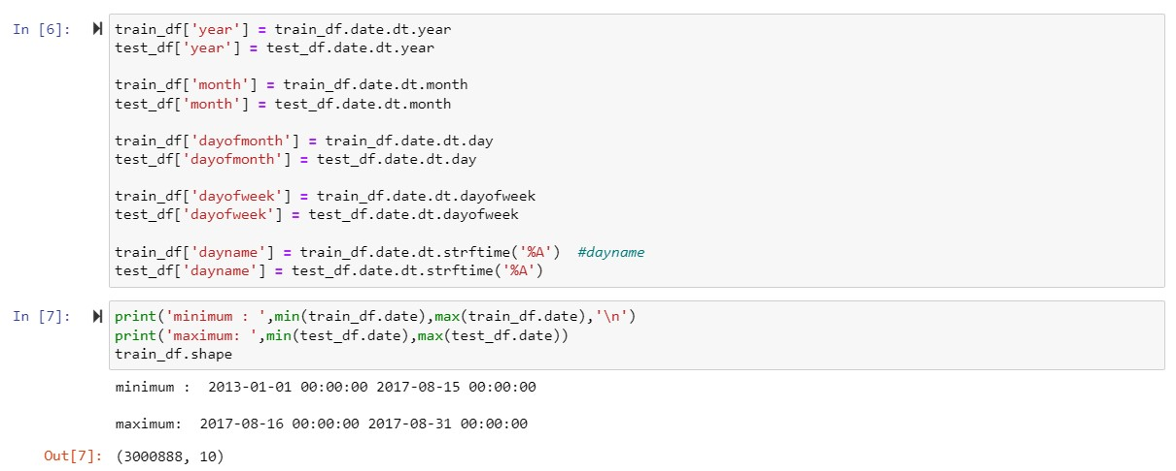

Slide 26
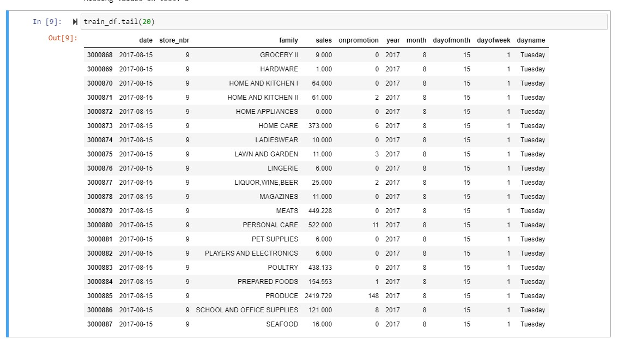

Slide 27
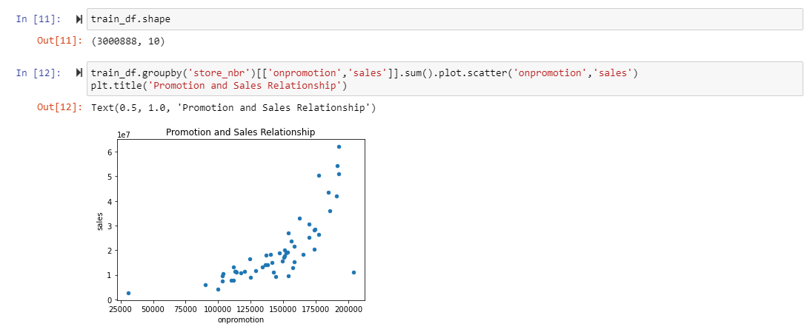

Slide 28
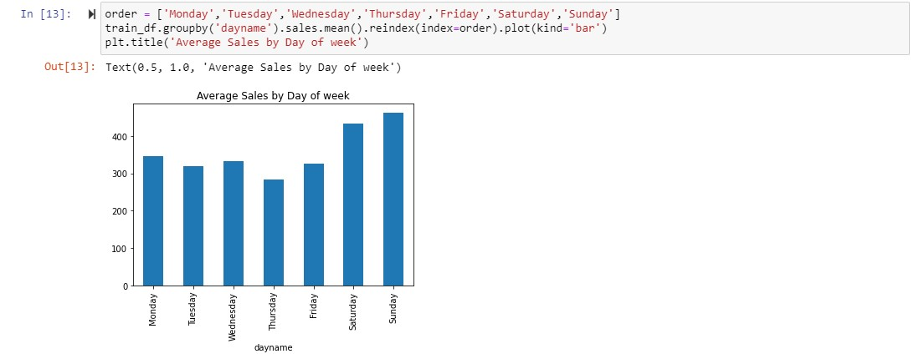

Slide 29
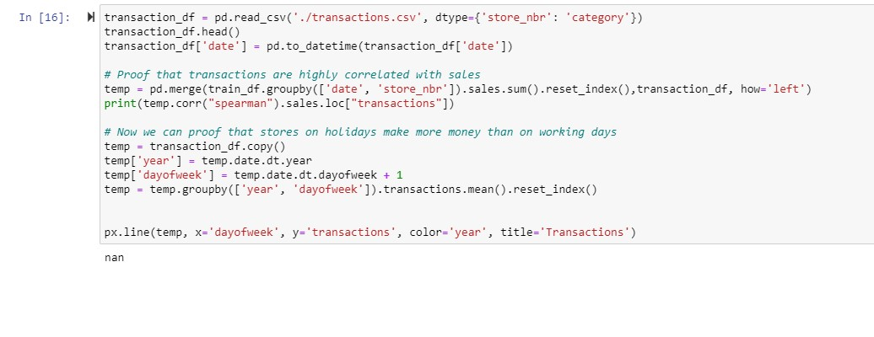
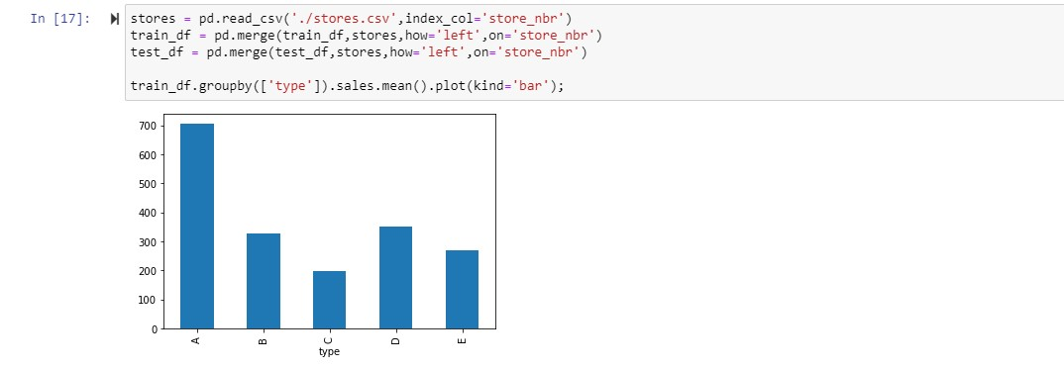

Slide 30
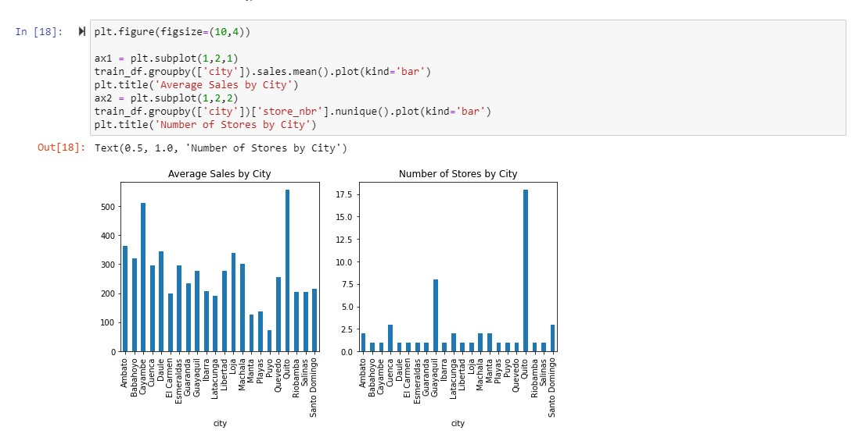

Slide 31
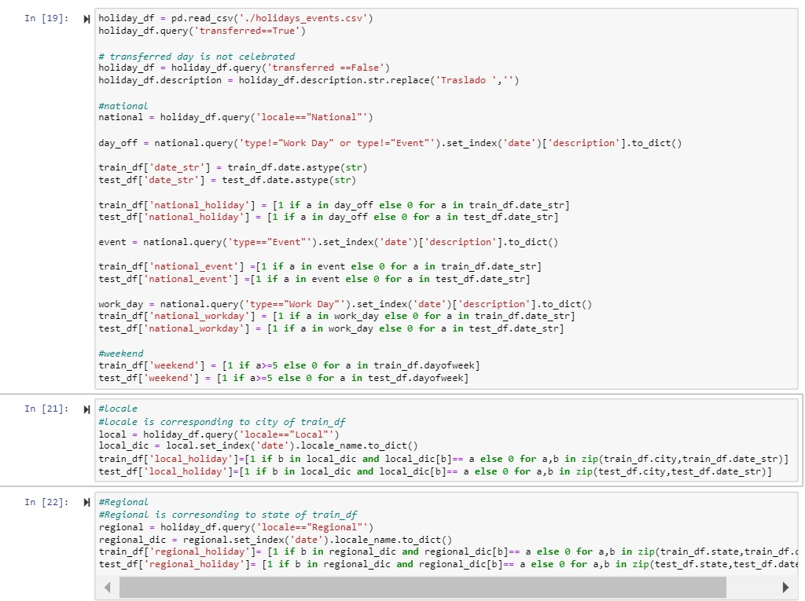

Slide 32
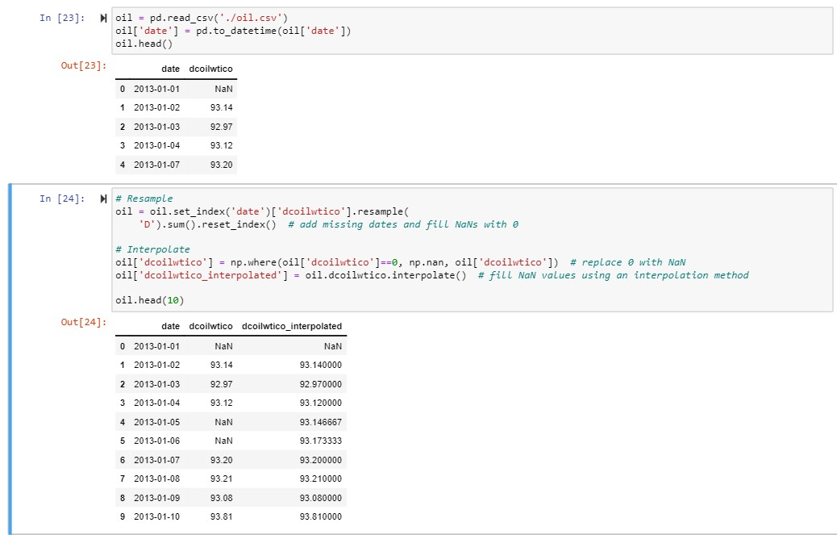
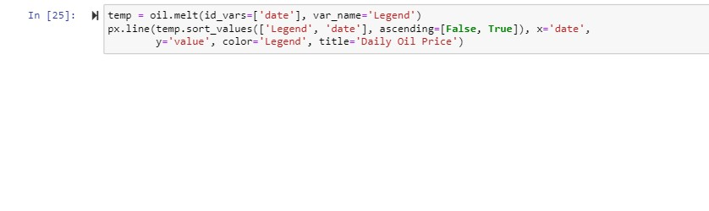

Slide 33
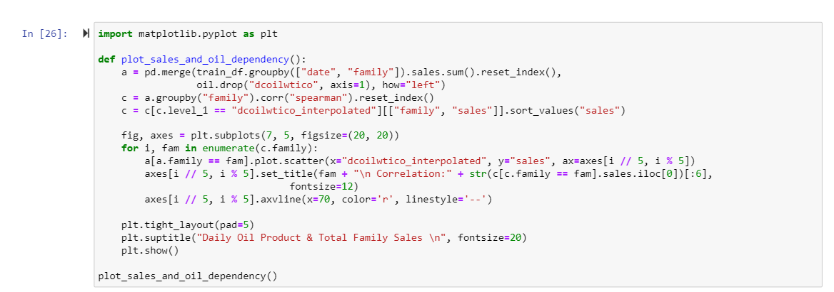
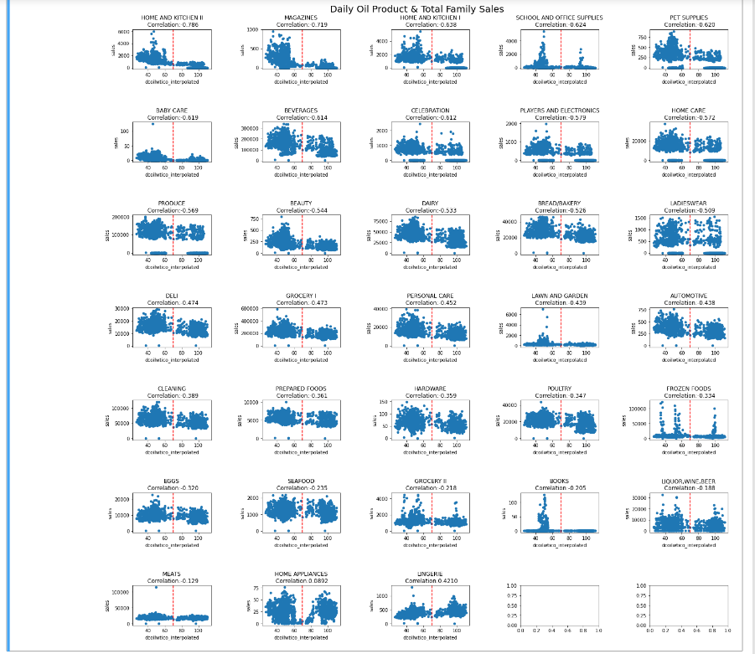

Slide 34
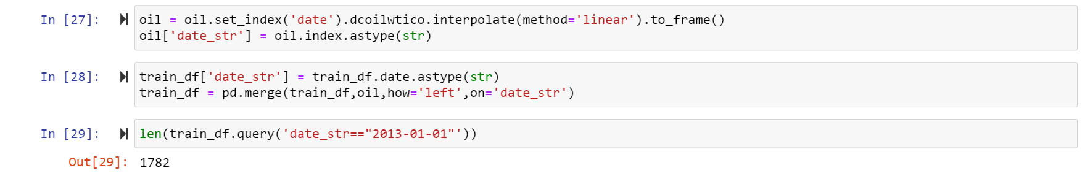

Slide 35
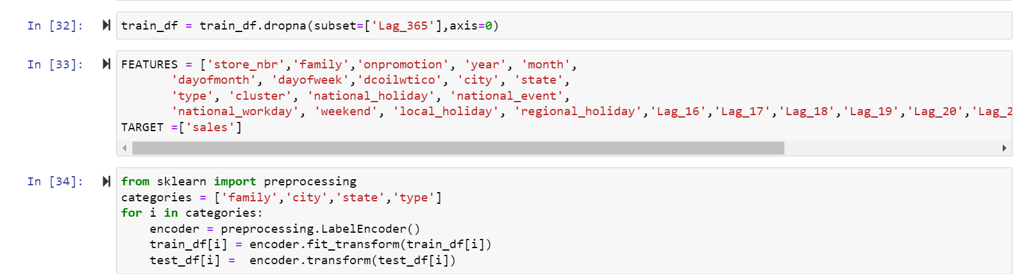

Slide 36
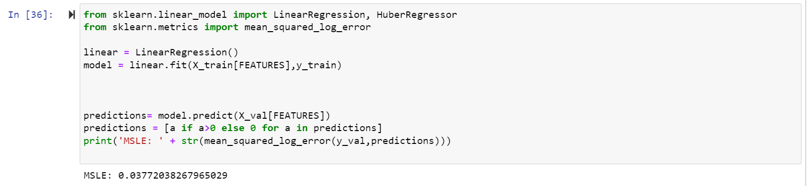

Slide 37
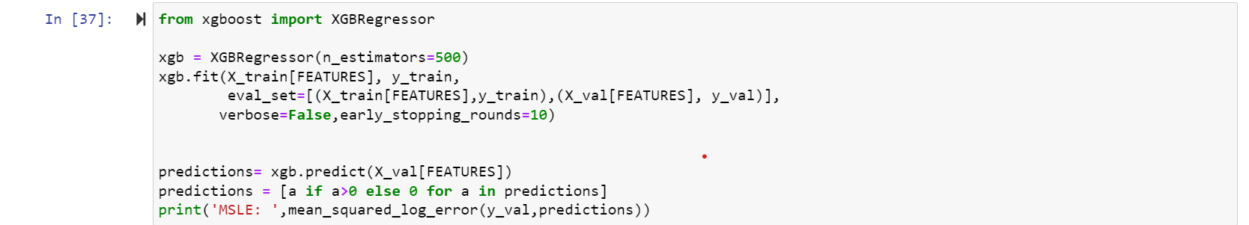


Slide 38
Thankyou!

